Slide 1
Airband and your community
- Cheddon Fitzpaine

Slide 2
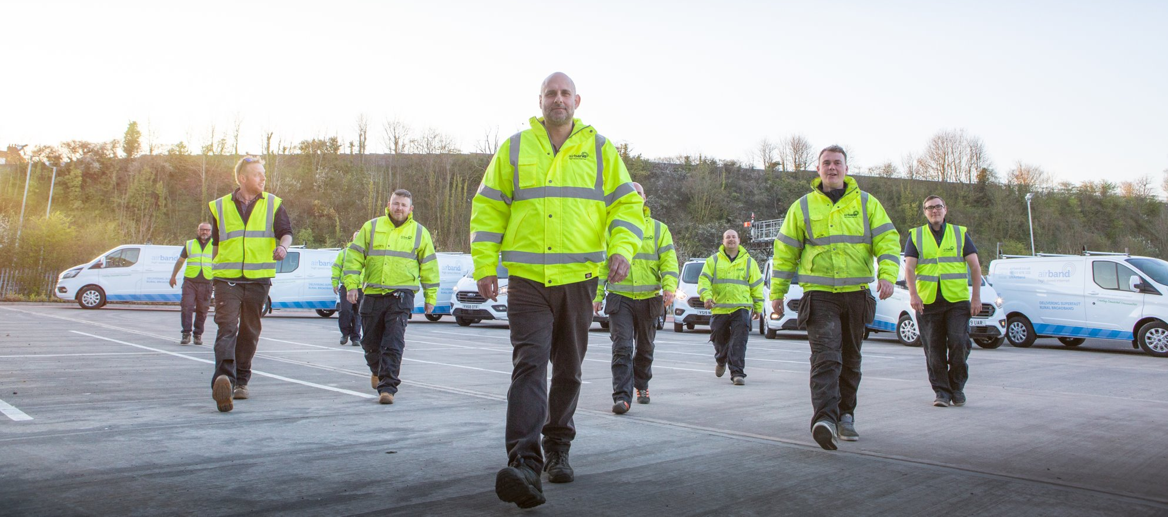
Agenda
Airband: First choice for true ultrafast rural broadband
Project overview
Cheddon Fitzpaine Plan
Fibre to the premise (FTTP)
Broadband packages
Register your interest
Installation
FAQ

Slide 3
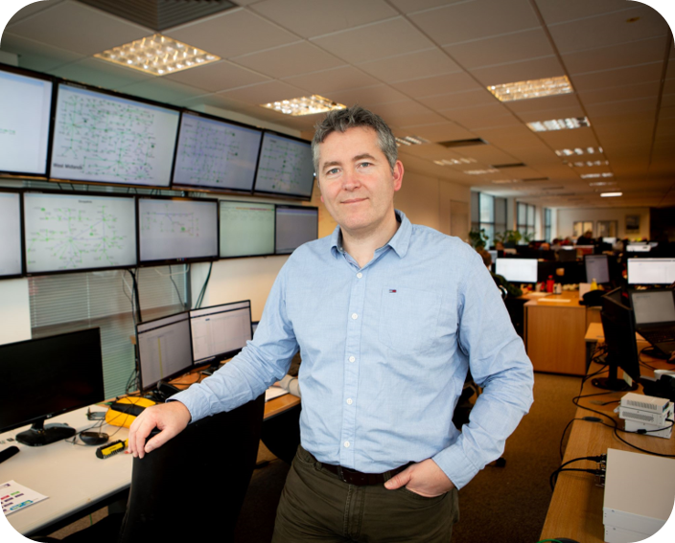

Airband
Founded in 2009, Airband is an independent internet service provider (ISP) bringing high speed broadband to homes, business and industry in rural and hard-to-reach areas. ​
​
We are proud to work with the Department for Digital, Culture, Media & Sport, BDUK, local authorities and communities to build high availability infrastructure that residents, businesses and other ISPs can access to help overcome the UK’s digital divide. ​
​
Trusted by governments, industry partners and communities to bring the fastest, most reliable broadband service to rural communities, industrial parks and outdoor sites. ​
​
​

Slide 4
Project Overview
You may have heard that Airband, in partnership with Connecting Devon & Somerset, has been commissioned to build a brand new, ultrafast FTTP (Fibre To The Premises) broadband network to transform connectivity in your area.
Over the coming weeks and months, we will be working in rural areas across the county, including weekend work, but rest assured that disruption will be kept to an absolute minimum.
Work may involve accessing existing underground ducts and telegraph poles.
You may also see some new telegraph poles being erected at various locations. For the most part, these new poles will be situated along roads away from residential areas.
We are working closely with the local authorities to plan and implement the network build.

Slide 5
Cheddon Fitzpaine Plan
C10
Surveying due to begin from Quarter 2, 2021
Build planned for Quarter 3, 2021
Completion due end Quarter 3, 2021
Build dates estimated, timings may change

Slide 6
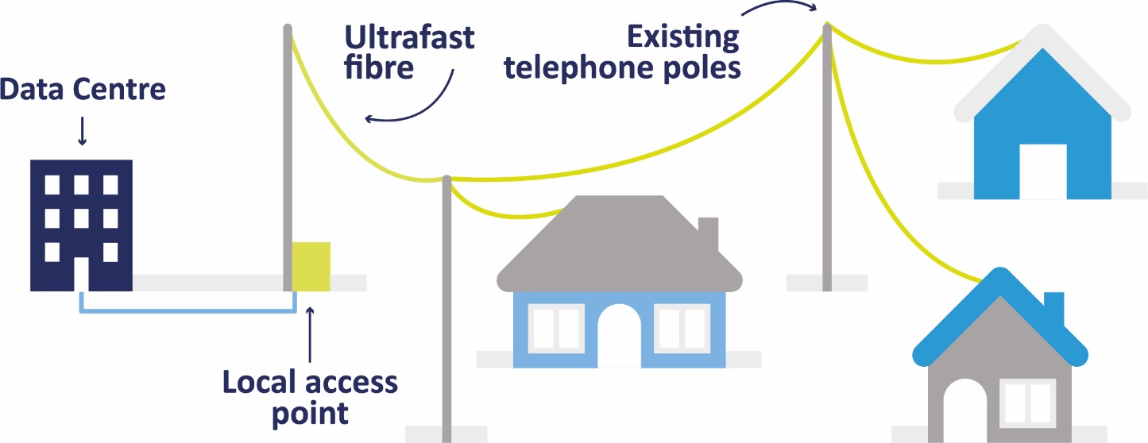
Fibre to the Premise (FTTP)
What does FTTP stand for?
FTTP stands for Fibre To The Premises. At Airband we provide this service across our network, bringing ultrafast speeds of up to 1Gbps to our customers in more rural areas. There’s no line rental or phone line required, so the price you see is the price you get.
What is Fibre To The Premises (FTTP)?
Fibre To The Premises (FTTP) replaces old copper broadband lines; fibre optic cables are run from your local exchange direct to your premises.
Fibre broadband that’s faster and more reliable
Because the fibre cable comes right into the building, there is less ‘contention’ which gives you a faster and more reliable broadband experience.

Slide 7
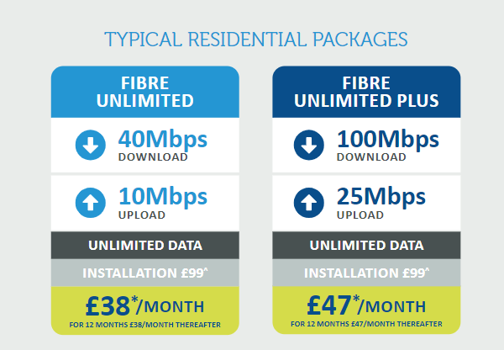
Broadband Packages
An Introductory offer will be available shortly. This is generally in the region of £29 and £39 for the packages above. There also business packages available

Slide 8
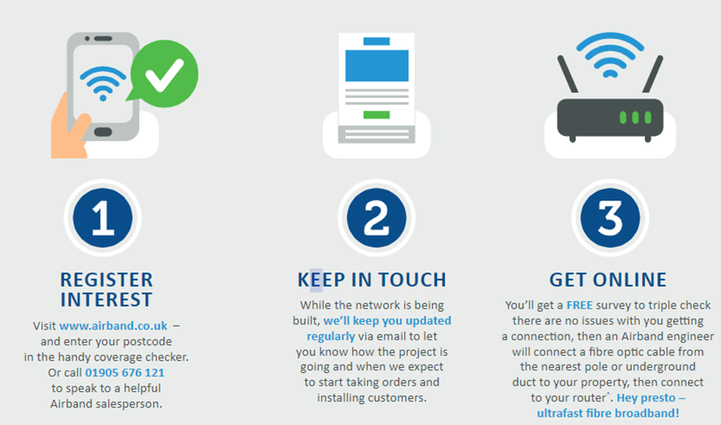
Register Your Interest
The website is currently being updated with your postcodes.
This work should be complete by mid May.

Slide 9
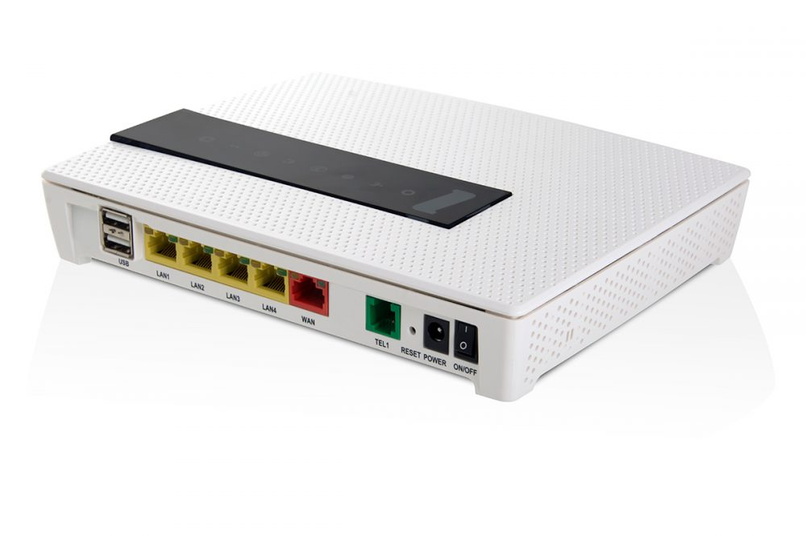

Installation
Twist Port
Fibre Router

Slide 10
What is the installation cost?
A standard installation is £99 subject to survey. This price includes the twist port and router
How will you get to my premise?
To minimise disruption wherever possible we will use existing ducts and telegraph poles to bring the fibre underground or overhead, however some premises may require additional infrastructure.
I am in a contract can I wait to sign up?
A range of options are also available for people wishing to switch contract. Please contact us to find out more
Can I upgrade my service speeds?
We can offer upgrade packages for extra speeds during the life of your contract.
What support services do you offer?
Our helpdesk operates 24 hours a day, 7 days a week. All residential packages come with a free standard 5-day Service Level Agreement (SLA). Enhanced SLA’s and business services are available.
FAQ

